Slide 1
Course Modules
Database Fundamentals
01 | Introducing core database concepts (50 minutes) Define databases, example of relational database tables, and introduce common database terminology
02 | Relational Concepts (50 minutes) Normalization, referential integrity, and constraints
03 | Creating databases and database objects (50 minutes) Data types, database objects, DDL statements, and creating scripts
04 | Using DML statements (50 minutes) DML statements, using the SELECT statement; using INSERT, UPDATE, and DELETE to manage data; indexes and triggers
05 | SQL Server Administration Fundamentals (50 minutes) SQL Server security; securing database and objects; performing database backups and database restores

Slide 2
Module Overview
Introduce relational databases
Introduce common database components and terms
Discuss the three types of commands used to manage SQL Server

Slide 3
Database Introduction

Slide 4
Database
A database (db) is an organized collection of data, typically stored in electronic format
It allows you to input, manage, organize, and retrieve data quickly
Traditional databases are organized by records (rows), fields (columns) stored in tables which are stored in the database files

Slide 5
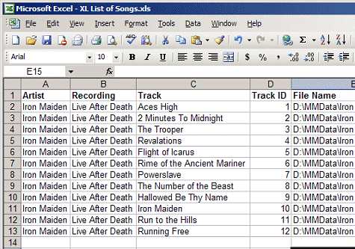
Excel ‘tables’
The idea of a table shouldn’t be new to you if you have used Excel, as that has rows and columns of information and the structure of a SQL Server table is similar to that of an Excel spreadsheet

Slide 6
Tables
A database table is a collection of rows and columns that is used to organize information about a single topic. Each row within a table corresponds to a single record and contains several attributes that describe the row.
These tables are stored in databases
EmployeeID | LastName | FirstName | Department
100 | Smith | Bob | IT
101 | Jones | Susan | Marketing
102 | Adams | John | Finance

Slide 7
Relational databases
A relational database a collection of tables of data all of which are formally described and organized according to the relational model. Each table must identify a column or group of columns, called the PRIMARY KEY, to uniquely identify each row

Slide 8
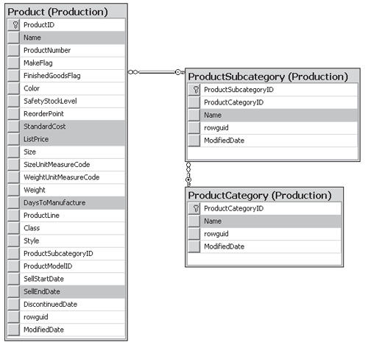
Sample relational structure

Slide 9
Common Terms

Slide 10
Database Management System (DBMS)
Database Management System (DBMS) is used by the users to access the data stored in database files. A DBMS is also used to perform administrative tasks on the databases and objects contained within the database.
DBMS is a collection of applications that allows users and other programs to capture and analyze data by providing additional functionality like reporting services to help you create, deploy, and manage reports for your organization.
A RDBMS is a software system designed to allow the definition, creation, querying, and updating of data stored in relational databases.
A few examples of RDBMS include; Microsoft SQL Server, Microsoft Access, and MySQL

Slide 11
Database servers
Databases are stored on database servers which are dedicated physical or virtual servers that host the database files and provide high-level performance for users who are accessing the data.
Database servers contain the DBMS used to manage the data and administer the SQL Server environment.
A database server can have one default instance and several named instances of SQL Server. A SQL Server instance is a copy of the sqlservr.exe program that runs as a Windows operating system service.
Often multiple database servers are deployed to provide high availability and improve performance

Slide 12
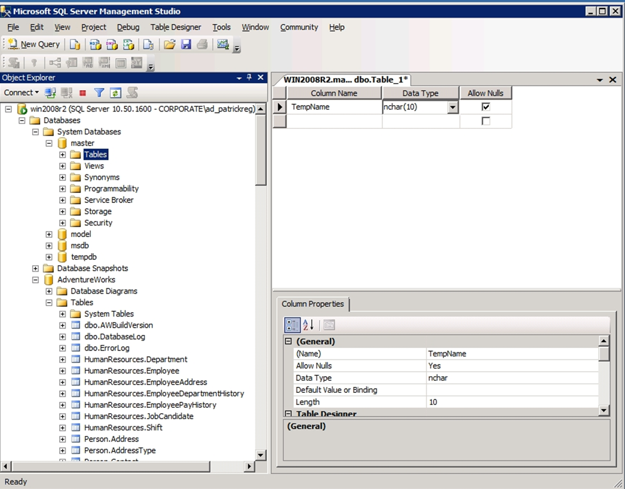
SQL Server Management Studio (SSMS)
A graphical user interface (GUI) used to browse, select, and manage the SQL Server instance and any of the objects within that SQL Server instance.

Slide 13
Demo
Exploring SSMS

Slide 14
Summary
A database (db) is an organized collection of data, typically stored in electronic format.
Microsoft SQL Server and MySQL are examples of relational databases
DBMS is application used to perform administrative tasks on databases and used to interact with data stored in databases.

Slide 15
Summary
Database server hosts DBMS system and one or more instances of SQL Server
SQL Server Management Studio (SSMS) is the GUI used to manage SQL Server, its databases, and the content contained within the databases

